Slide 1
VeriBetrFS: Towards a fast, verified file system
Travis Hance
With Jon Howell, Rob Johnson, and Andrea Lattuada

Slide 2
File systems
People want two things from their file systems:
They want them to be fast.
They want them to not lose data.
How do we achieve these goals?
Use fast data structures.
Verify the implementation.

Slide 3
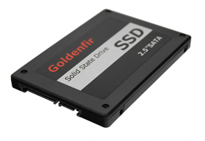




Hoare Logic
Hoare logic is the standard tool for formally reasoning about program behavior.
Statements in Hoare logic are given by triples (P, c, Q). P and Q are logical statements about the state of the program before and after the execution of program c.
P
c
Q
“Disk is a well-formed filesystem image”
“Write to a file”
“Disk is a well-formed filesystem image”

Slide 4
What’s the challenge?
Crash Safety is paramount for a file system.
Hoare logic only lets us make statements about programs with run to completion.
Makes reasoning about crash-safety awkward.

Slide 5
Extremely brief Hoare Logic introduction
Hoare logic lets you reason about programs which run to completion.
Hoare logic uses triples (P, c, Q) where
P is a mathematical assertion
c is a program
Q is a mathematical assertion
The Hoare triple (P, c, Q) says that if P is true, and the program c is executed, then Q will be true.
P = Q = The disk is in a well-formed state.
c = A big program that manipulates disk state.
Then (P, c, Q) says that the program will leave the disk in a well-formed state, but it says nothing about the state of the program in the middle of c!

Slide 6
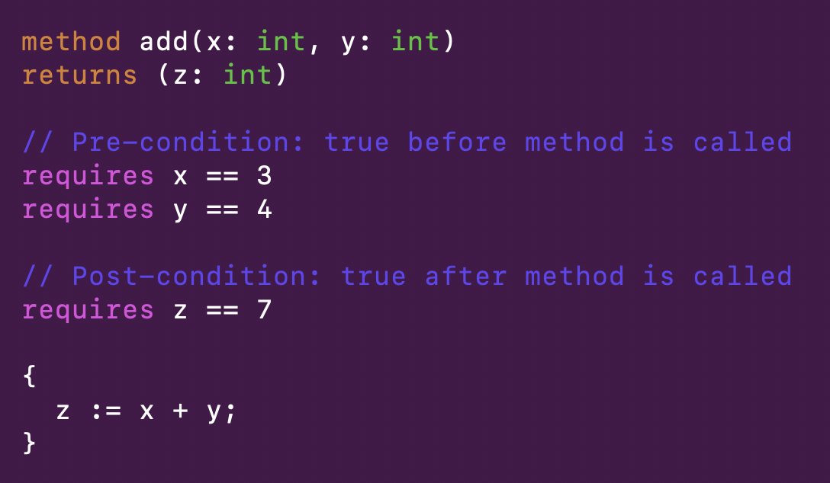
Extremely brief Hoare Logic introduction

Slide 7
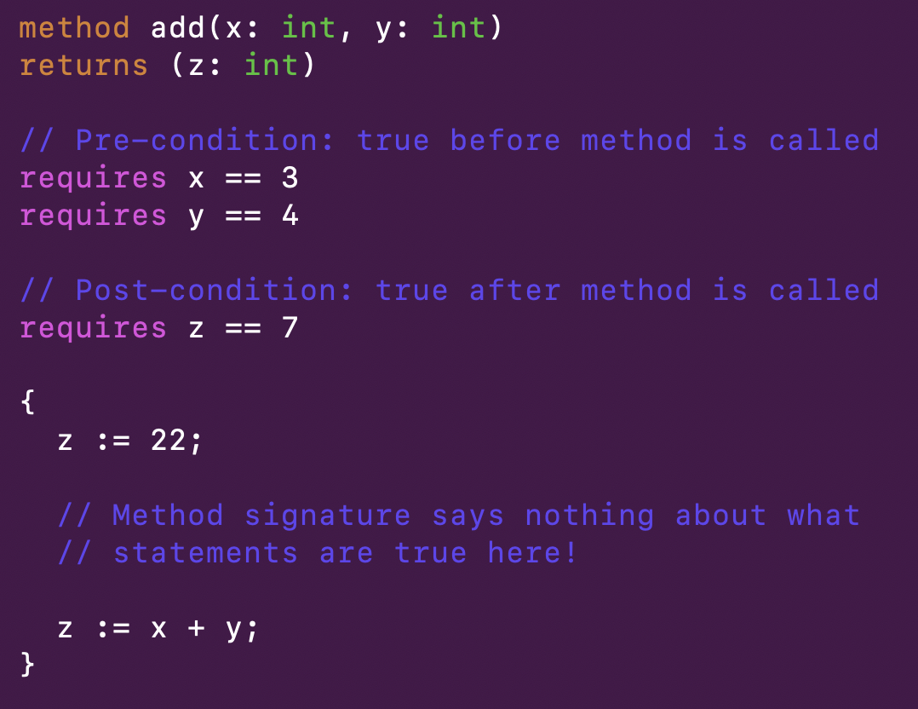
Extremely brief Hoare Logic introduction

Slide 8
State of the art
Specialized verification tools
Crash Hoare Logic – crash semantics are baked into the logic
Used to verify conventional (inode based) file systems.
Our work
Verification methodology with flexible mechanism for modeling crashes.
Implementation is based on BetrFS

Slide 9
Our results
Verification methodology with flexible mechanism for modeling crashes.
Works with general tools.
Made it easy to model:
Async IO (IO reordering, etc.)
Disk corruption.
Working prototype
~ 50,000 operations / second
~ 23,000 lines of code
Implementation is based on BetrFS

Slide 10
Background: BetrFS
BetrFS is a fast, write-optimized file system
Main design component is the B^{ε}-tree
B^{ε}-tree acts as a Key-Value Store

Slide 11
What’s a Key-Value Store spec look like?
Put (a, 1)
Put (b, 3)
Query b
3
{ a : 1,
b : 3 }
{ a : 1,
b : 3 }
{ }
{ a : 1 }
Put (b, 6)
CRASH
Put (b, 3)
Query b
6
{ a : 1,
b : 6 }
{ a : 12,
b : 6 }
{ a : 12,
b : 6 }
{ a : 1,
b : 6 }
{ a : 1 }
{ a : 12 }
????????

Slide 12

What about a Crash-Safe Spec?
Put (a, 1)
Put (b, 3)
Query b
3
{ }
{ }
fsync
{ a : 1 }
{ a : 1,
b : 3 }
{ }
{ a : 1 }
{ a : 1 }
{ a : 1 }
Put (b, 5)
Query b
5
{ a : 1 }
{ a : 1 }
{ a : 1 }
{ a : 1 }
{ a : 1 }
CRASH
{ a : 1,
b : 3 }
{ a : 1,
b : 5 }
{ a : 1,
b : 5 }

Slide 13
So how do we verify things?
We need a system where we can:
Write a spec.
Write a model of how a disk behaves.
Write a program.
Prove that the program matches the spec.

Slide 14
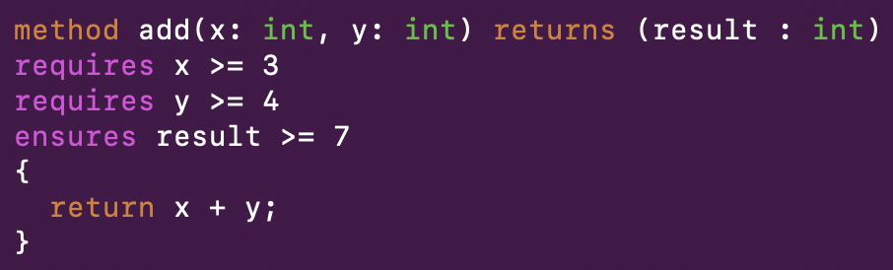
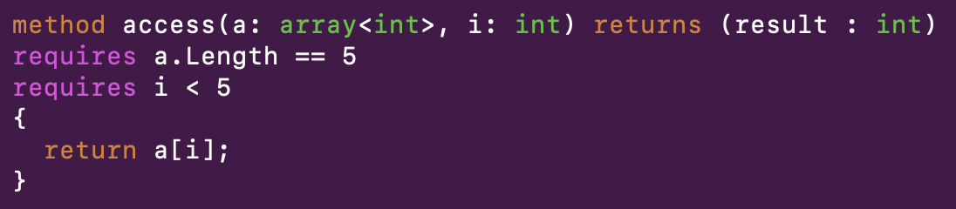
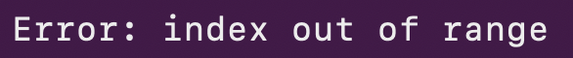

Verification with Dafny

Slide 15
So how do we verify things?
We need a system where we can:
Write a spec.
Write a model of how a disk behaves.
Write a program.
Prove that the program matches the spec.

Slide 16
TLA

Slide 17
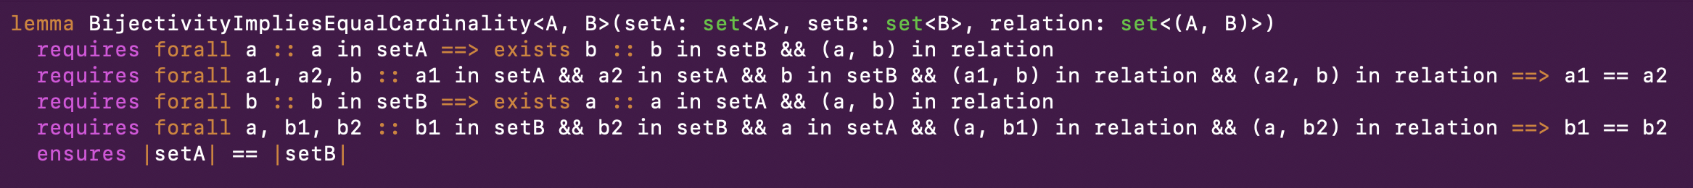
Verification with Dafny
Dafny doesn’t only verify things about running code – it has a rich functional subset for writing mathematical proofs.

Slide 18
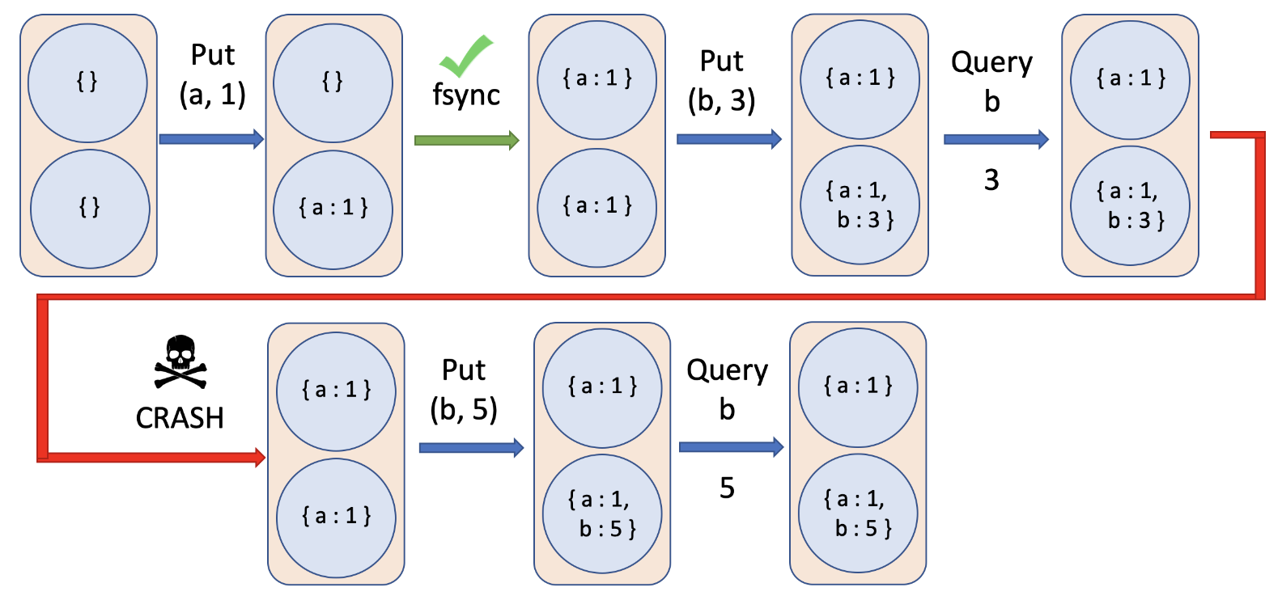
We have a specification now … right?
Key-Value
Store
Desired behavior
B^{ε}-tree logic
+
caching layer
Program
Disk
Environment
Crashing

Slide 19
System state machine
Program state machine
Disk state machine
{a : 1}
{a : 1}
Empty cache
CRASH
Process write, update storage
Process read, retrieve data
Read a page from disk into the cache
Insert a (key, value) pair
Write a page back out to disk

Slide 20
System State transitions
Program subsystem
Fault page into cache
Write-back to disk
Evict page from cache
Purely in-memory operations
B^{ε}-tree restructuring
Insert (key, value) pair into tree
Query for key
Disk subsystem
Perform Read
Perform Write
System-wide
Crash
“Environment”

Slide 21
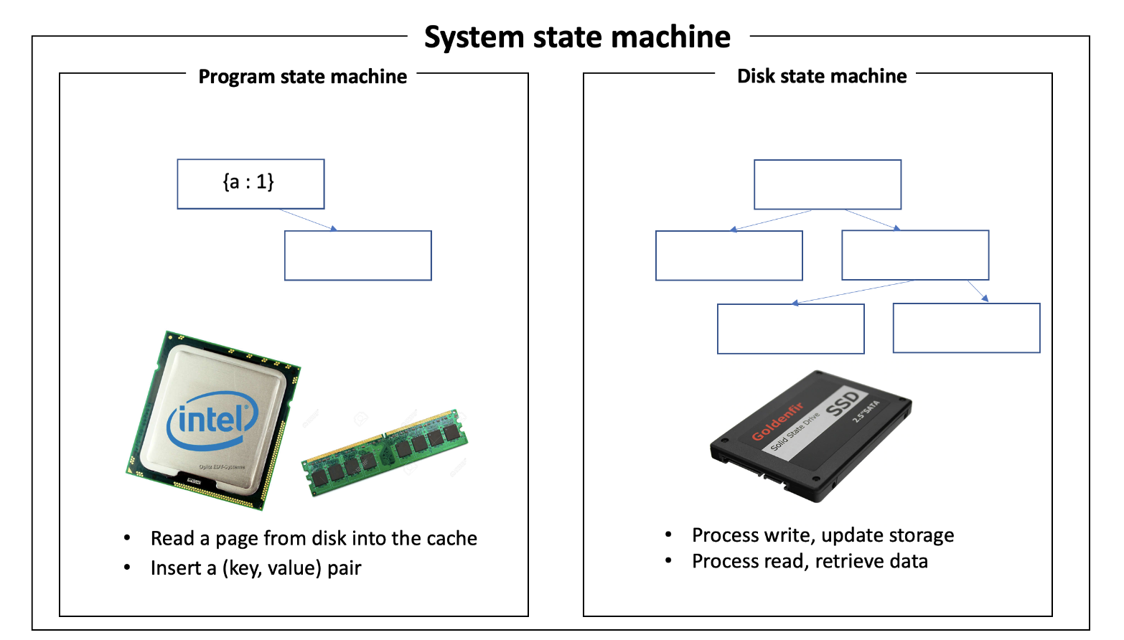
We have a specification now!
Key-Value
Store
Desired behavior
Program
The implementation
Environment
How do we verify that the implementation exhibits the desired Key-Value behavior?

Slide 22
System model
101
01010110001
1011
Program
Disk
Program
00
11010101
11010100100
11
00101011011
IO to and from disk
Disk updates storage
Program can advance in-memory state

Slide 23
How do we know if some execution of the implementation ought to be allowed?
Page
in
Query
a
Return
1
Write
page
back to
disk
Put
(a,1)
Query
a
Return
3

Slide 24
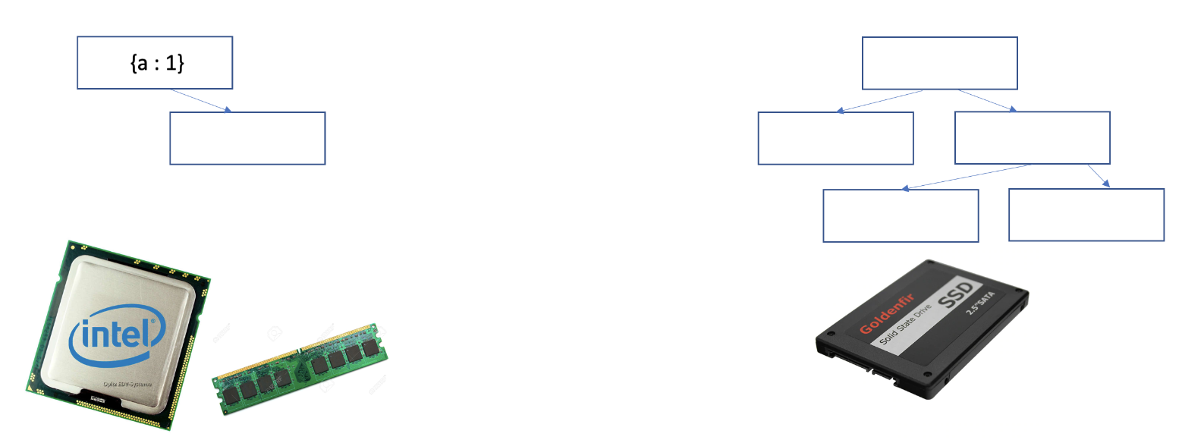
State machine refinement
An abstraction function f is a function that maps the state-space of one state machine to the state of another.
If x can transition to y then f(x) can transition to f(y).
Persistent –
Disk only
{b : 1}
f
{ b : 1}
{ a : 1,
b : 1 }
Ephemeral –
Disk + cache

Slide 25
State machine refinement
Put (a, 1)
Query a
3
Query a
1
{ }
{ }
{ }
{ }
{ a : 1 }
No-op
fsync
{ }
{ }
{ a : 1 }
{ a : 1 }
{ a : 1 }
Page
in
Query
a
Return
1
Write
page
back to
disk
Put
(a,1)
Query
a
Return
3

Slide 26
State machine refinement
Put (a, 1)
{ }
{ }
fsync
{ a : 1 }
{ a : 1 }
CRASH
{ }
{ a : 1 }
{ a : 1 }
{ a : 1 }
f
f
f
f
f
Page
in
Put
(a,1)
Write back to disk
CRASH

Slide 27
Implementation
Refinement proof
250 lines
Desired behavior
16,000 lines
5 layers of refinement
6,000 lines
Program
300 lines
Environment
Unit tests: 0
Integration tests: 0

Slide 28
Purple diagram
Spec
Beps tree
pivot tree

Slide 29
Crash-Safe Key-Value Store
State machine correspondence
System model
Program Model
Disk Model
Standard Hoare Logic
Program

Slide 30
Program Model
Cache architecture diagram

Slide 31
Crash-Safe Key-Value Store
System model
Program Model
Disk Model
Program

Slide 32
Conclusions
The state machine approach to system verification is general and allows us to flexibly model disk and crash behavior.
Made it easy to model:
Async IO (IO reordering, etc.)
Disk corruption.
Prototype which can do about ~50,000 operations / second

